Slide 1
Data Processing Architectures
The difficulty is in the choice
George Moore, 1900

Slide 2
Chapter Summary
Distinguish between the ‘traditional’ architectures surrounding business databases.
Client server (2-3-4)
Distinguish between the types of Cloud Computing Architectures
Distinguish between the manner in which databases can be distributed.

Slide 3
Architectures

Slide 4
Remote job entry
Local storage
Often cheaper
Maybe more secure
Remote processing
Useful when a personal computer is:
Too slow
Has insufficient memory
Software is not available
Some local processing
Data preparation

Slide 5
Personal database
Local storage and processing
Advantages
Personal computers are cheap
Greater control
Better interface
Disadvantages
Replication of applications and data
Difficult to share data
Security and integrity are lower
Disposable systems
Misdirection of attention and resources

Slide 6
Client/server
Client is typically a Web browser
Client initiates request
Server responds
Savings
Ease of use / fewer errors
Less training

Slide 7

Thin client
Diskless computer
Browser-based apps
Need an Internet connection
$200-300

Slide 8
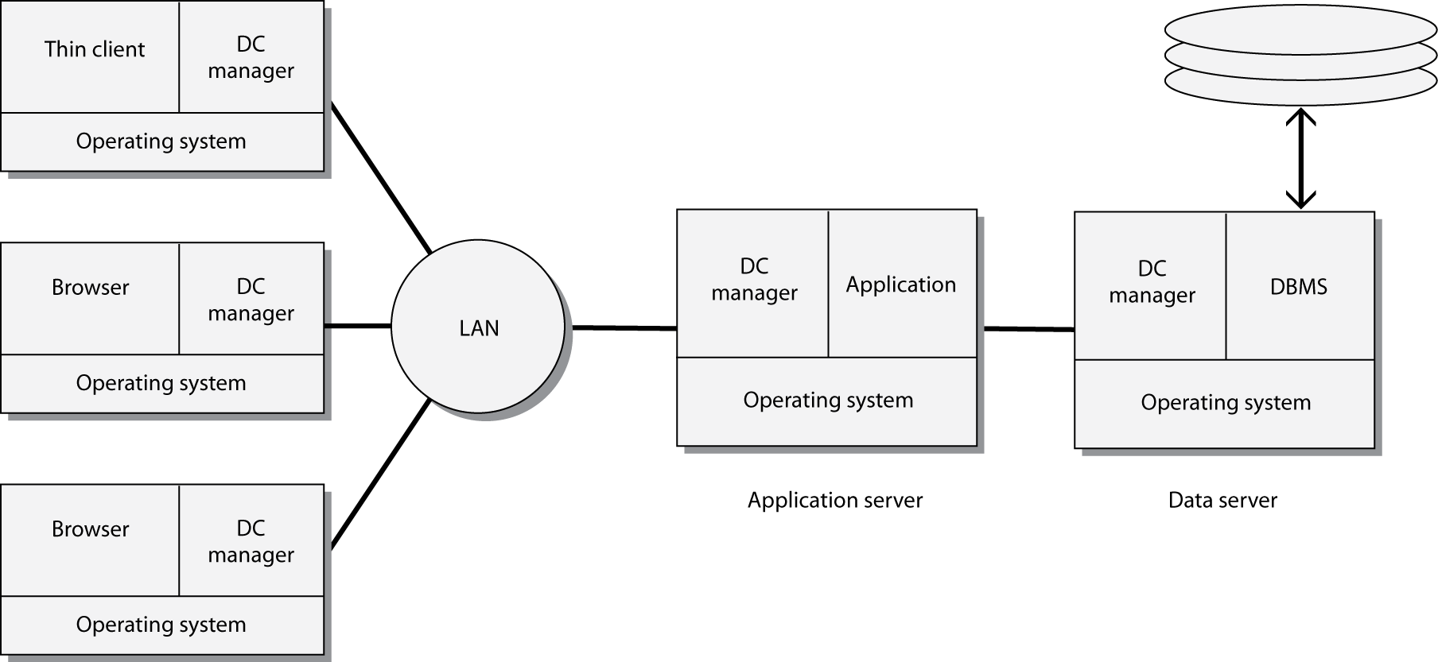
Three-tier client/server

Slide 9
Three-tier model
Clients
Browser with graphical user interface (GUI)
Application servers
Business and data logic
Data servers
Database
Backup and recovery services

Slide 10
Advantages of the three-tier model
Security is higher because logic is on the server rather than the PC
Performance is better
Access to legacy systems and a variety of databases
Easier to implement, maintain, and scale

Slide 11
Evolution of client/server computing
Architecture | Description
Two-tier | Processing is split between client and server, which also runs the DBMS.
Three-tier | Client does presentation, processing is done by the server, and the DBMS is on a separate server.
N-tier | Client does presentation. Processing and DBMS can be spread across multiple servers. This is a distributed resources environment.

Slide 12
Cloud computing
The provision of computing processing and storage resources via the Internet
Software and hardware resources are shared
Resources obtained on demand
Part of an evolution rather a revolution in the management of information
Clouds, such as time-sharing, have existed for decades

Slide 13
Cloud layers
Infrastructure
A virtual server over which the developer has complete control
Amazon
Platform as a service
A developer can build an application with the provided tools
Salesforce.com

Slide 14
Cloud layers
Application
Access to cloud applications
Google Docs
Collaboration clouds
A special case of application clouds
Facebook
Service
Consulting and integration

Slide 15
Types of clouds
Public
Private
Community
Hybrid

Slide 16
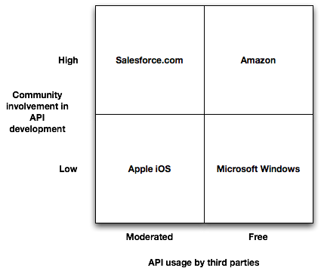
Capabilities of clouds
Interface control
To what extent can customers influence the interface to the cloud?

Slide 17
Capabilities of clouds
Location independence
Ubiquitous access

Slide 18
Capabilities of clouds
Sourcing independence
Can change suppliers easily at low cost
A goal rather than always a reality
Virtual business environments
Special needs systems can be built quickly and later abandoned
Rapid elasticity
Scale up and down as required
Easier to scale up than down

Slide 19
Strategic risks
Risk | Description
Demand | Fluctuating demand or market collapse
Inefficiency | Inability to match competitors’ unit costs
Innovation | Not innovating as well as competitors
Scaling | Not scaling fast and efficiently enough to meet market growth
Control | Inadequate procedures for acquiring or managing resources

Slide 20
Demand
Fluctuating demand or market collapse
Ubiquity enables serving customers everywhere
Elasticity to handle excessive demand

Slide 21
Inefficiency
Inability to match competitors’ unit costs
Cloud computing is generally cheaper
Single service center for all customers
Employees can work at home or on the road
Low cost testing of system innovations

Slide 22
Innovation
Not innovating as well as competitors
Interface control could be issue for innovation
Ubiquitous access makes it easier to engage customers and employees in product improvement

Slide 23
Scaling
Not scaling fast enough and efficiently enough to meet market growth
A firm can use the cloud’s elasticity to quickly acquire new storage and processing resources for digital products
It can take advantage of sourcing independence to use multiple clouds

Slide 24
Control
Inadequate procedures for the acquisition or management of resources
A well-designed interface is a control mechanism

Slide 25
Thinking
Most people think of cloud computing as an opportunity to lower costs by shifting processing from the corporate data center to a third party
More imaginative thinkers will see cloud computing as an opportunity to gain a competitive advantage

Slide 26
Clouds & strategic risks
Risk/Capability | Demand | Inefficiency | Innovation | Scaling | Control
Interface control |  |  | ✔ |  | ✔
Location independence |  | ✔
Sourcing independence |  | ✔ |  | ✔
Virtual business environment |  | ✔ | ✔
Ubiquitous access | ✔ | ✔ | ✔
Rapid elasticity | ✔ |  |  | ✔

Slide 27
Distributed database
Communication charges are a key factor in total processing cost
Transmission costs increase with distance
Local processing saves money
A database can be distributed to reduce communication costs

Slide 28
Distributed database
Database is physically distributed as semi-independent databases
There are communication links between each of the databases
Appears as one database

Slide 29
A hybrid
Architecture evolves
Old structures cannot be abandoned
New technologies offer new opportunities
Ideally, the many structures are patched together to provide a seamless view of organizational databases
Distributed database principles apply to this hybrid architecture

Slide 30
Fundamental principles
Transparency
No reliance on a central site
Local autonomy
Continuous operation
Distributed query processing
Distributed transaction processing

Slide 31
Fundamental principles
Replication independence
Fragmentation independence
Hardware independence
Operating system independence
Network independence
DBMS independence
Independence

Slide 32
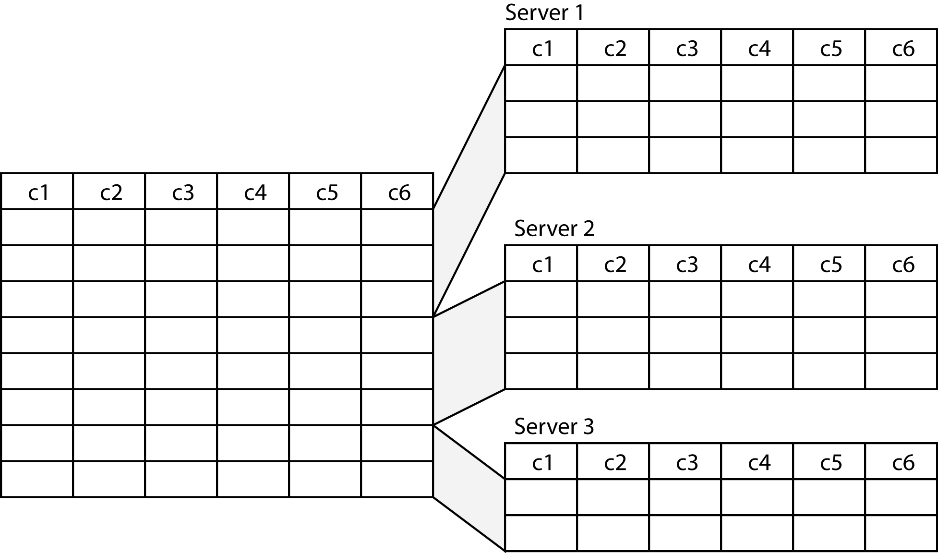
Horizontal fragmentation

Slide 33
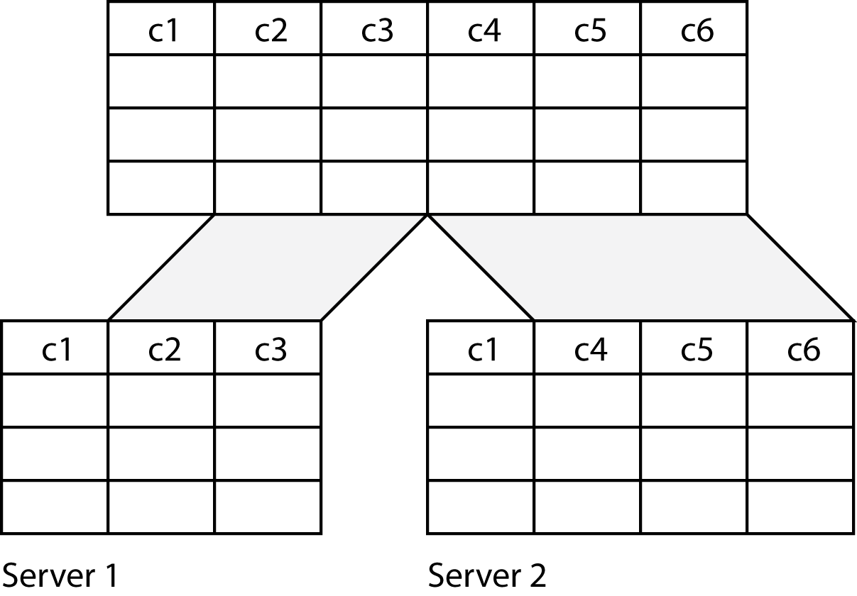
Vertical fragmentation

Slide 34
Replication
Full replication
Tables are duplicated at each of the sites
Increased data integrity
Faster processing
More expensive
Partial replication
Indexes replicated
Faster querying
Retrieval from the remote database

Slide 35
Key points
There are basic data processing architectures
N-tier client/server dominates today
Cloud computing offers cost savings and strategic opportunities
Databases can be distributed to lower communication costs and improve response time

